Slide 1
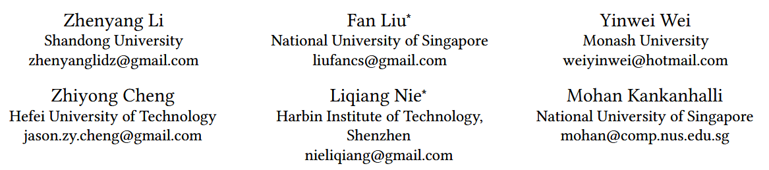





Attribute-driven Disentangled Representation Learning for Multimodal Recommendation
（ACM Multimedia -2024)
Reported by Jiale Shen

Slide 2
motivation
1.AD-DRL improves interpretability and controllability by employing attributes to disentangle factors in user and item representations.
2.To achieve robust and independent representations, we assign a specific attribute to each factor in multimodal features and disentangle factors at both the attribute and attribute-value levels.

Slide 3
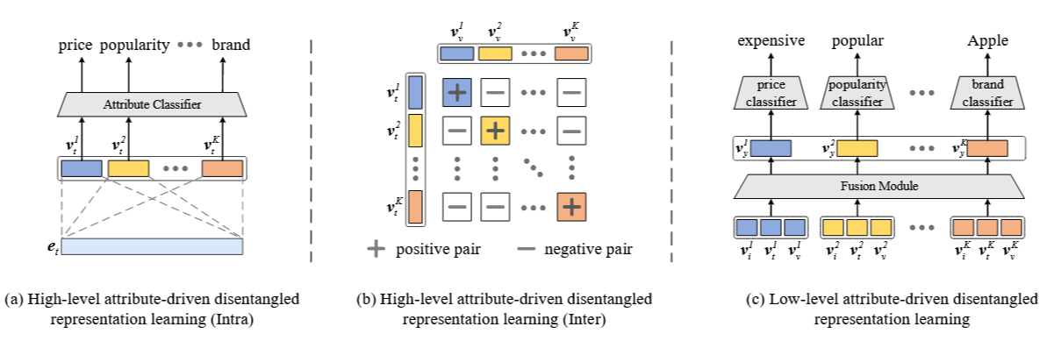
Overview

Slide 4
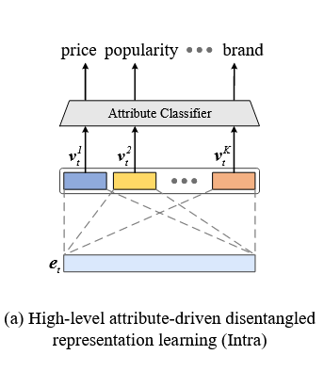


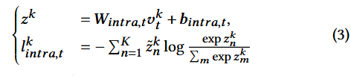

Approach

Slide 5
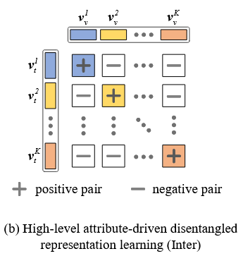
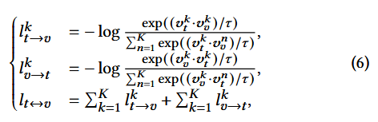

Approach

Slide 6
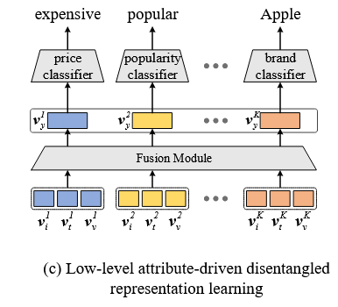


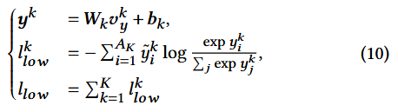
Approach

Slide 7



Approach

Slide 8
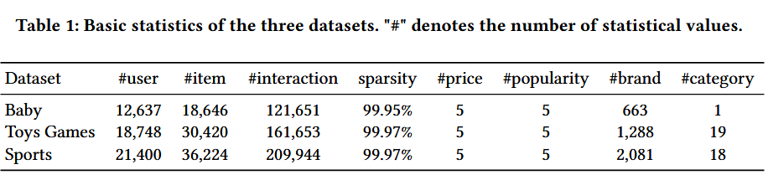
Experiment

Slide 9
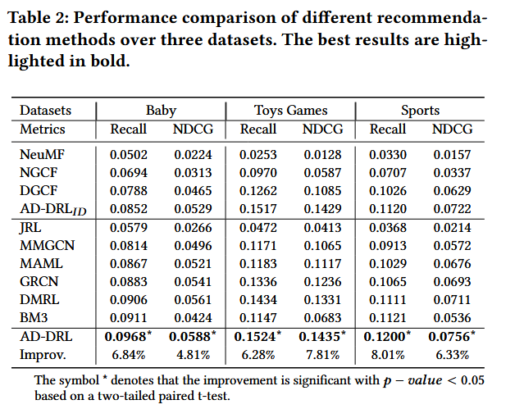
Experiment

Slide 10
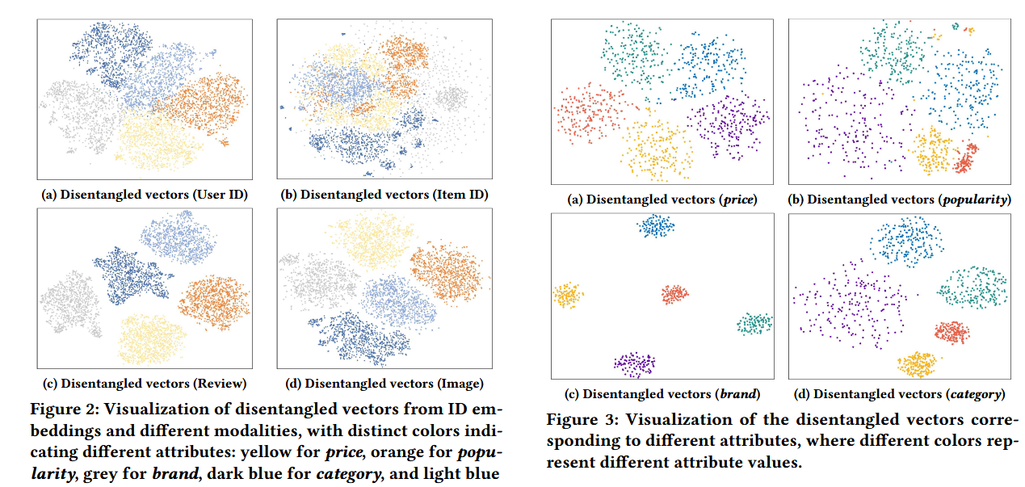
Experiment

Slide 11
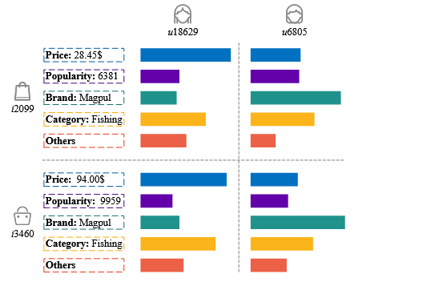
Experiment

Slide 12
Thank you!

